Slide 1

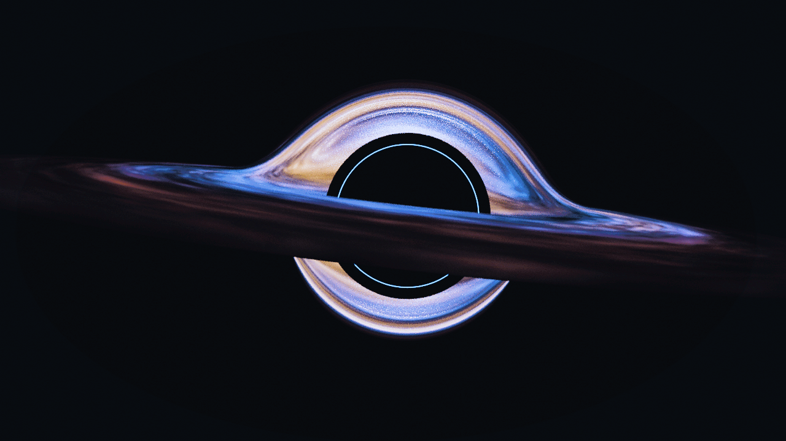

Portfolio
GAME ARTIST
Presented By:
Suman Biswas

Slide 2




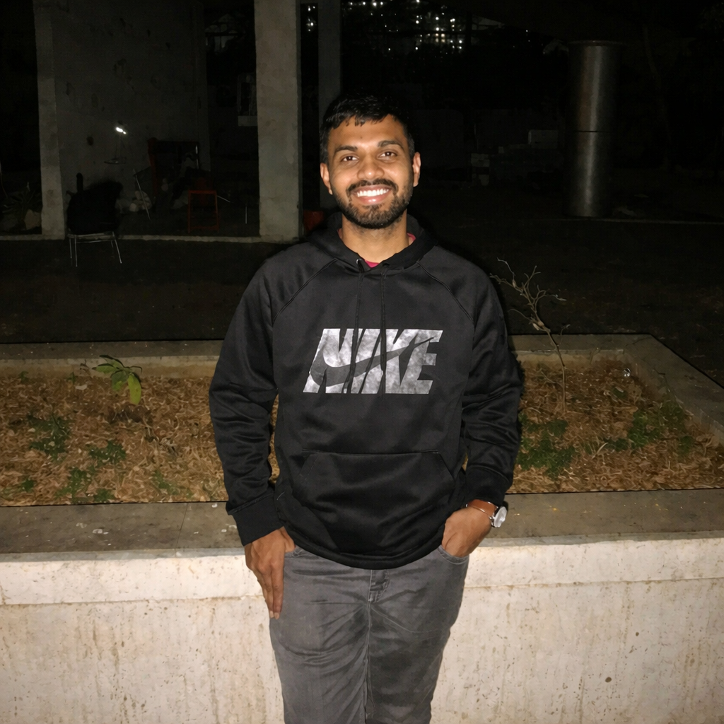
SKILLS
Suman Biswas
Introduction
Crafting Game-Ready 3D Art for Real-Time Worlds
I’m a 3D Artist and Unity Game Developer, focused on creating game-ready assets and real-time content. I spent nearly 1 year as a freelance 3D artist, followed by 3+ years as a Game Artist, contributing to multiple games across different styles.
My work includes 3D props, environments, and supporting assets like logos, icons, posters, and video content, with a strong understanding of Unity-based workflows.

Slide 3

PERSONAL
PROJECTS

Slide 4
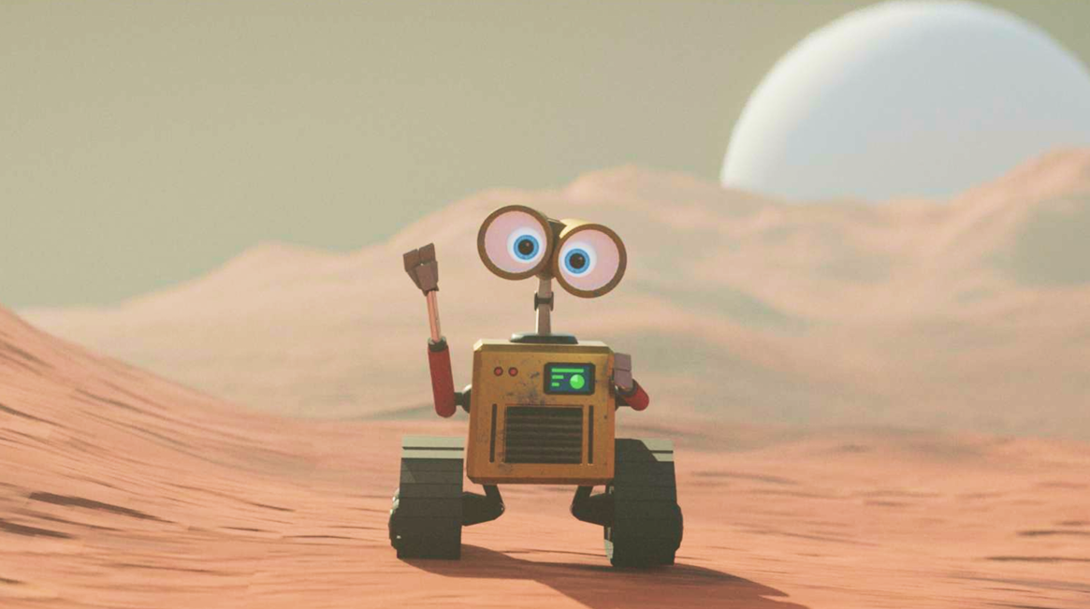
Where Curiosity Became Creation
Personal projects are where my love for games and curiosity about game worlds come together. What started as exploring how game environments and assets are made grew into a self-taught journey in 3D modeling and real-time art, driven by learning, experimentation, and creative freedom.

Slide 5
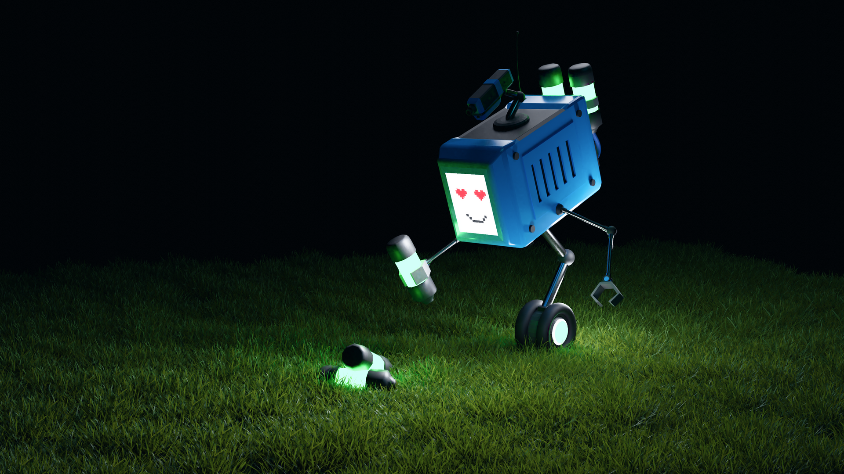
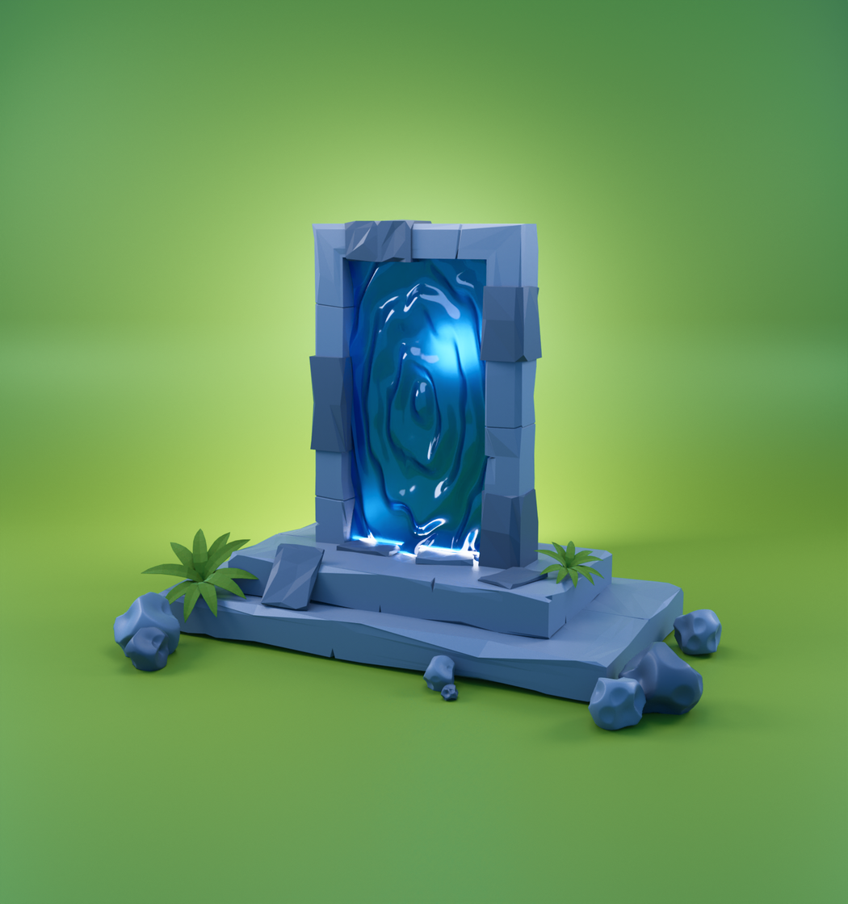
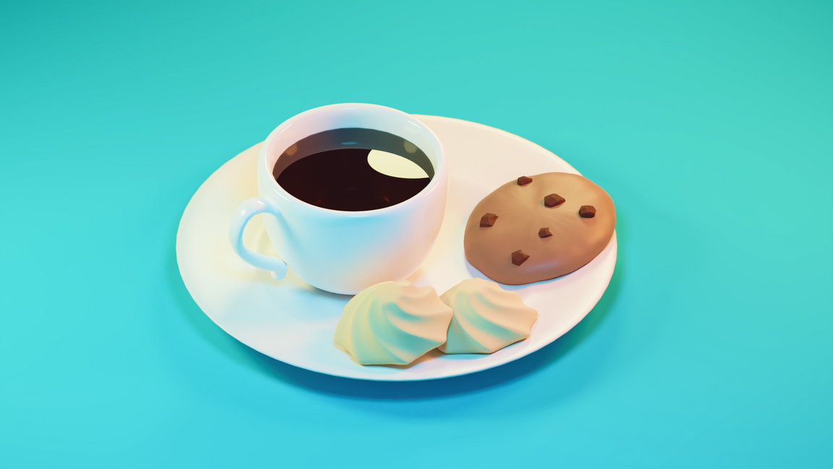
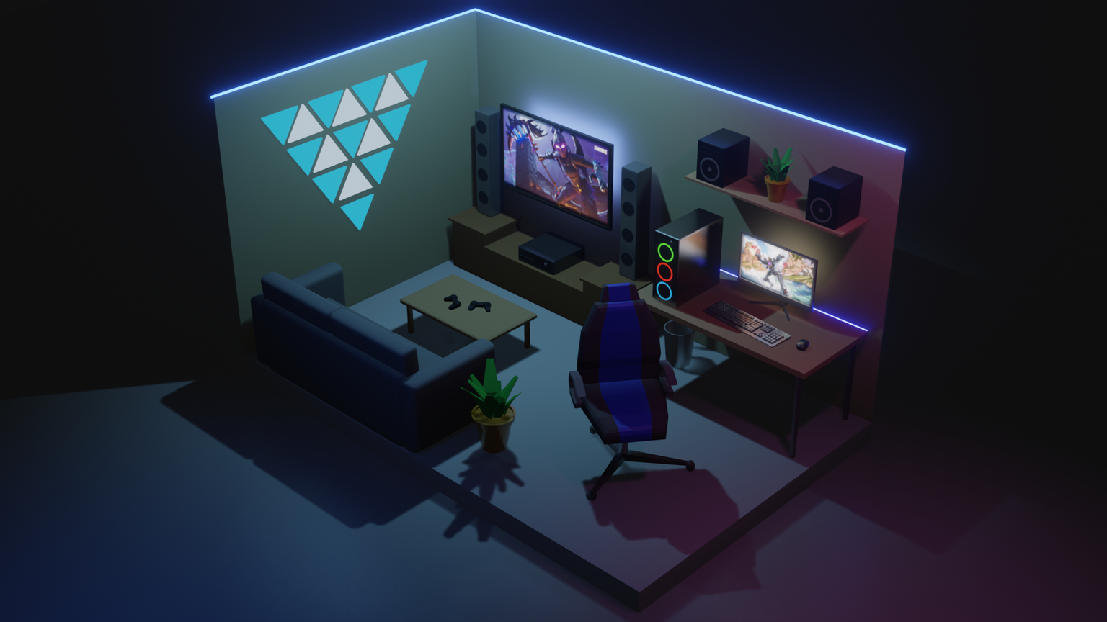
Personal
PROJECTS

Slide 6
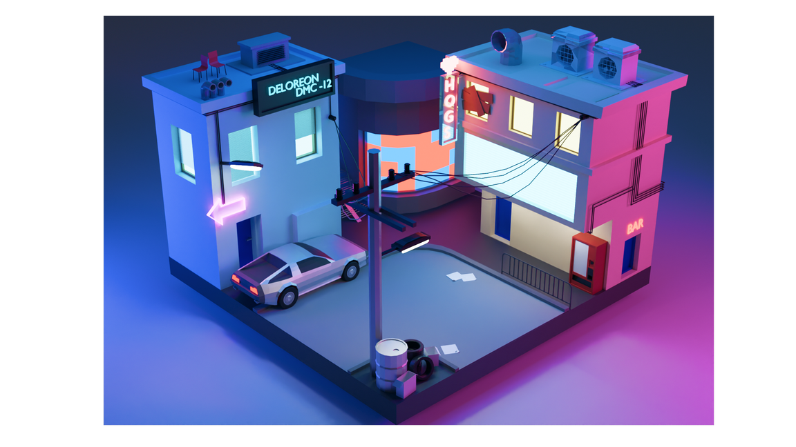
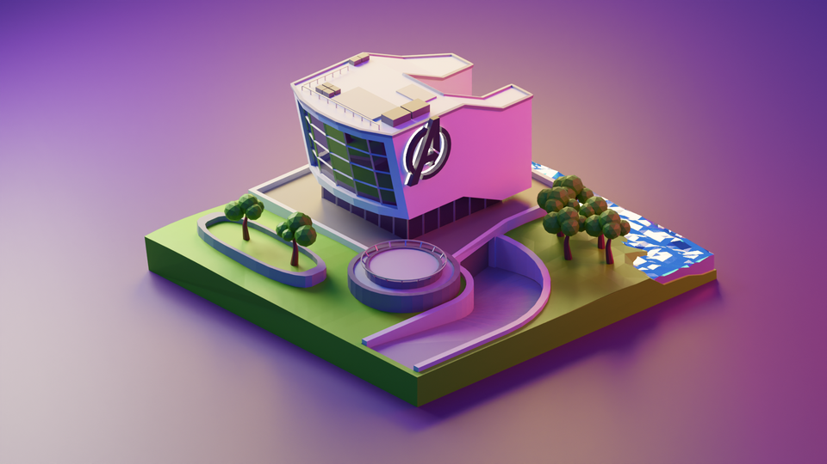
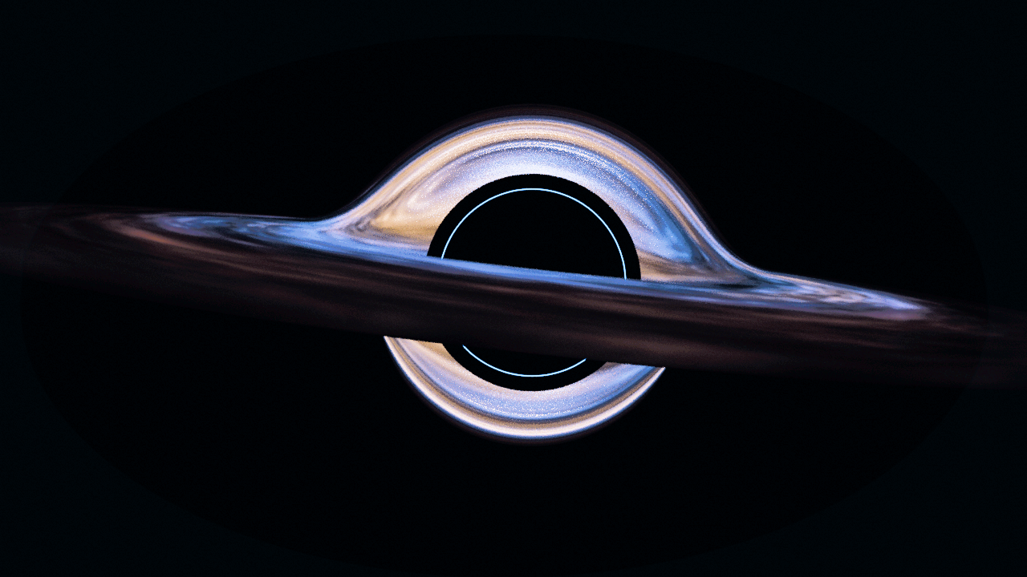
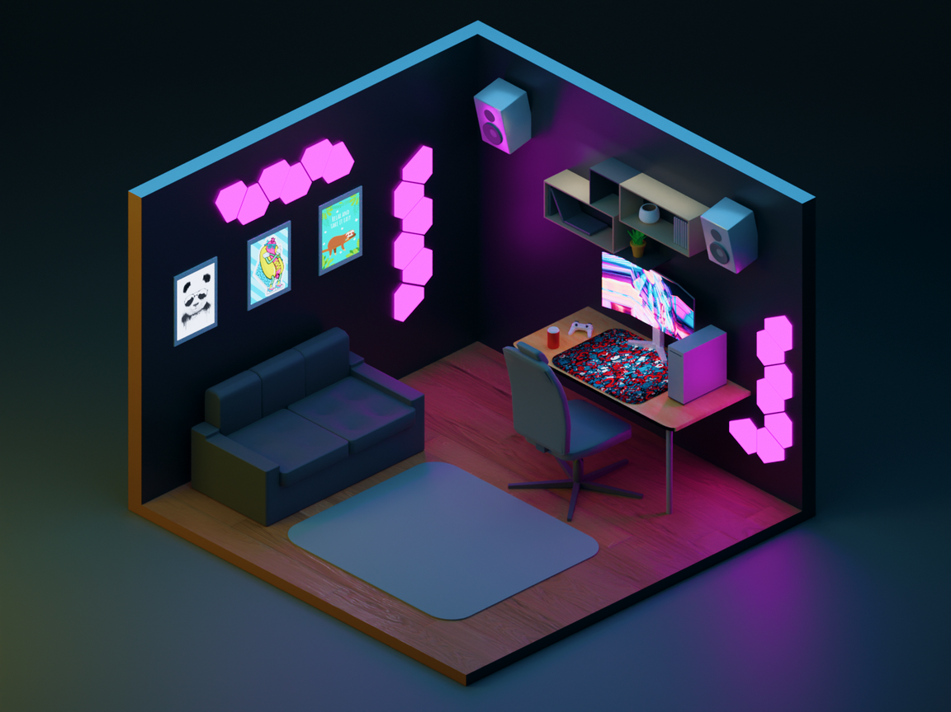
Personal
PROJECTS

Slide 7
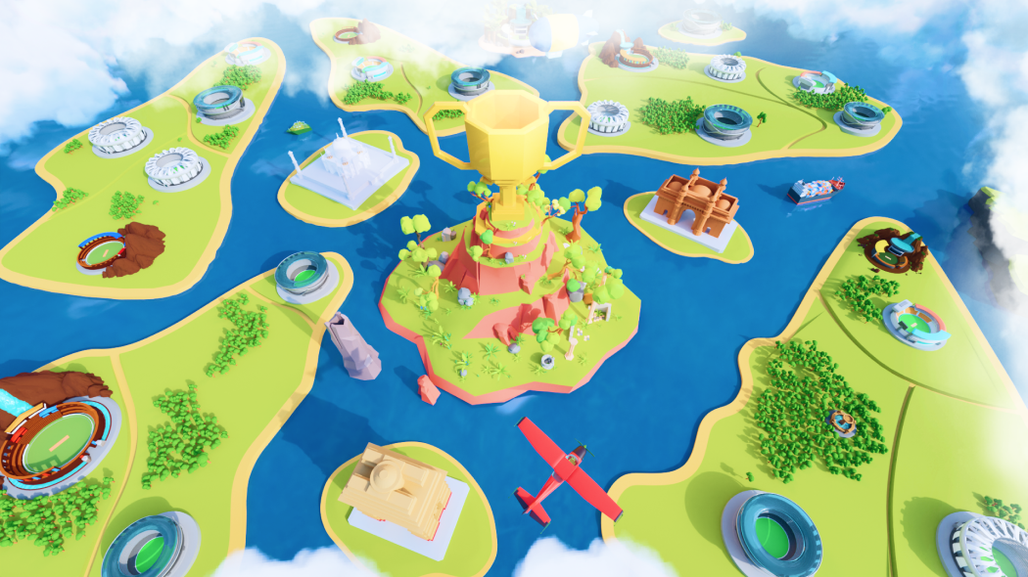

CRICKET CLASH
Wega Labs

Slide 8
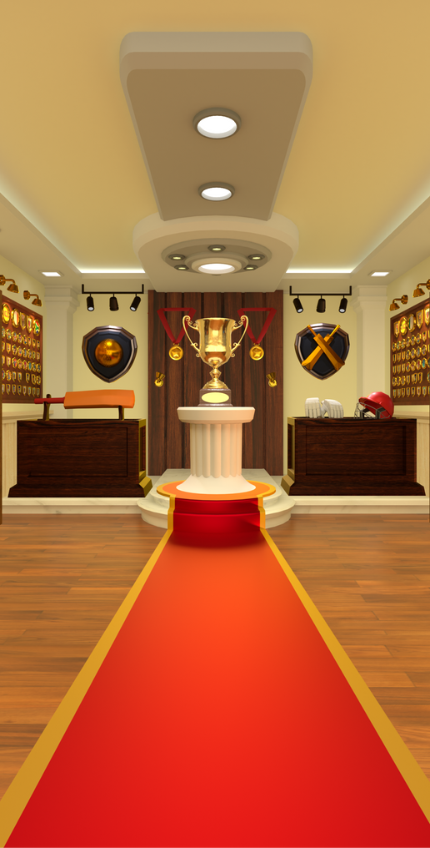
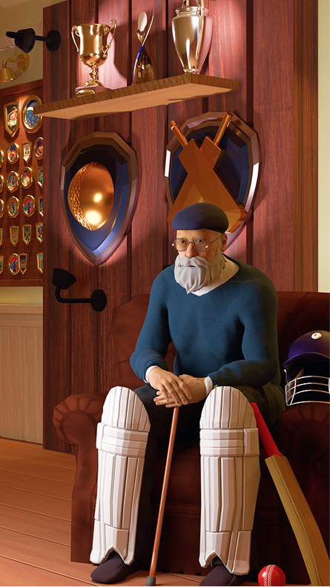
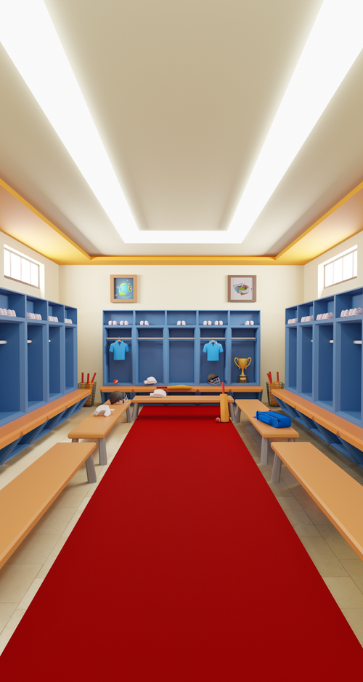
3D ENVIRONMENTS
Game-ready 3D environments designed to enhance immersion, storytelling, and player experience within interactive worlds.

Slide 9
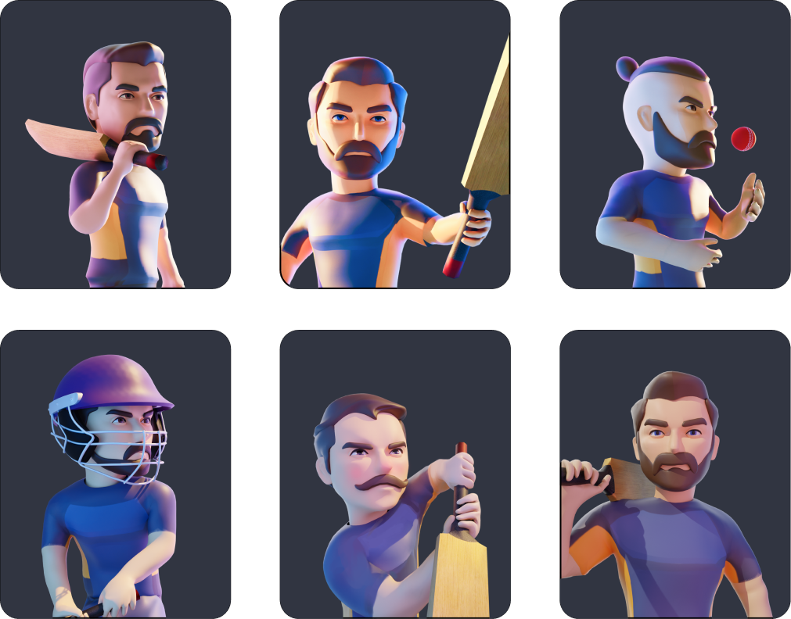
3D CHARACTERS
A set of stylized 3D characters developed for player cards and marketing content. Built to capture the spirit of cricket, the characters balance strong silhouettes and dynamic appeal, making them suitable for in-game presentation as well as promotional materials.

Slide 10
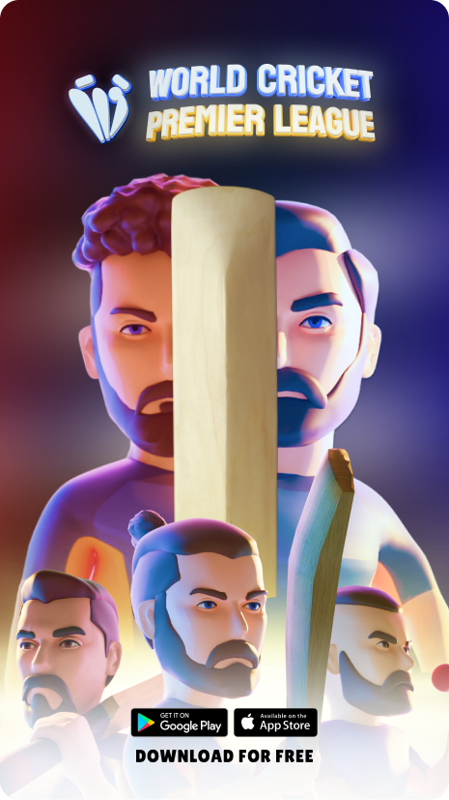
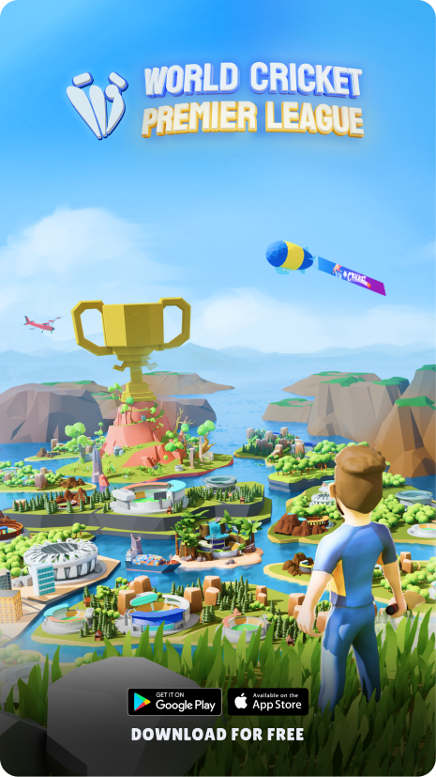
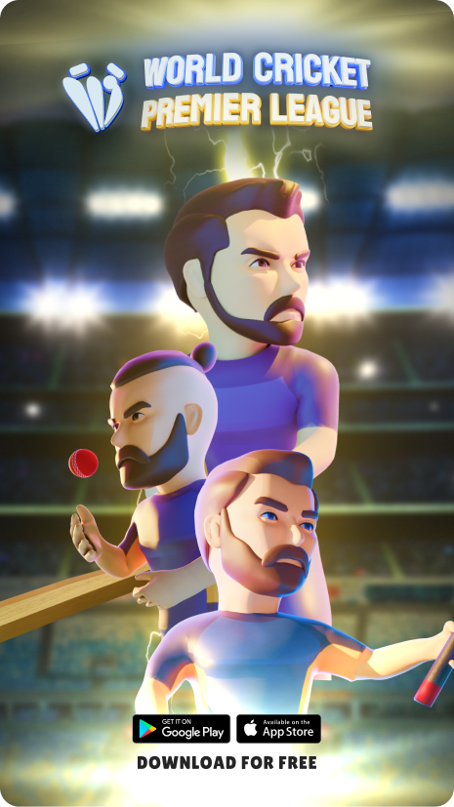
POSTERS

Slide 11
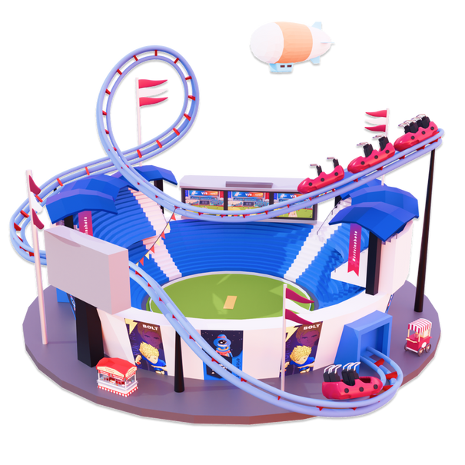
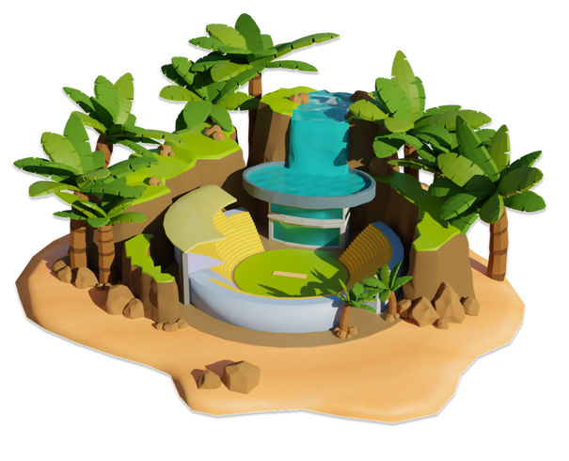
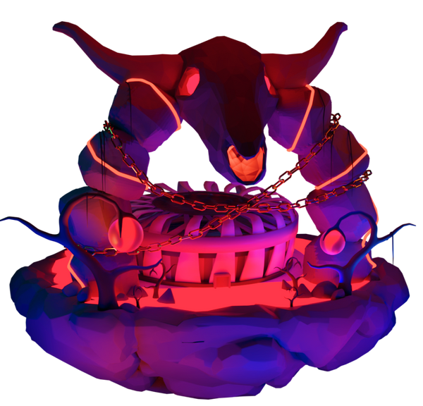
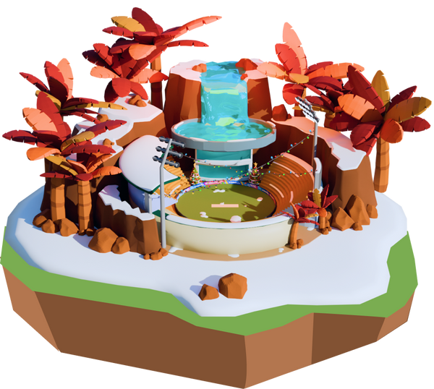
MINI STADIUMS ASSETS

Slide 12

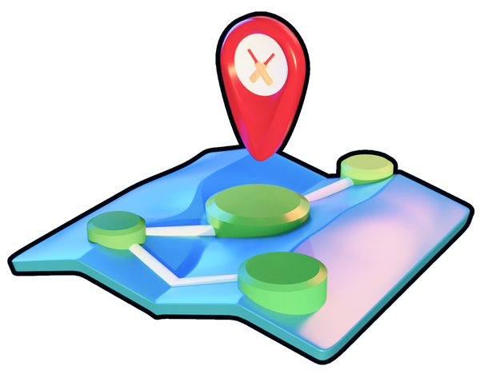

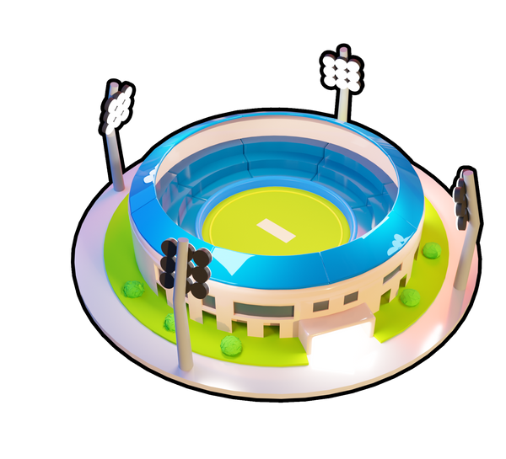
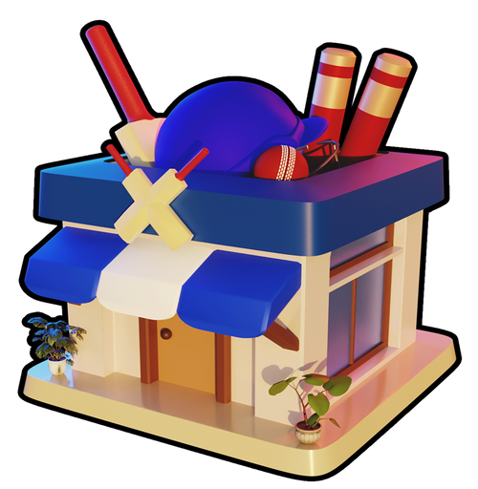

3D ASSETS
Stylized 3D assets designed for in-game currencies, boosts, and core gameplay elements, built to enhance clarity, usability, and overall game experience.

Slide 13
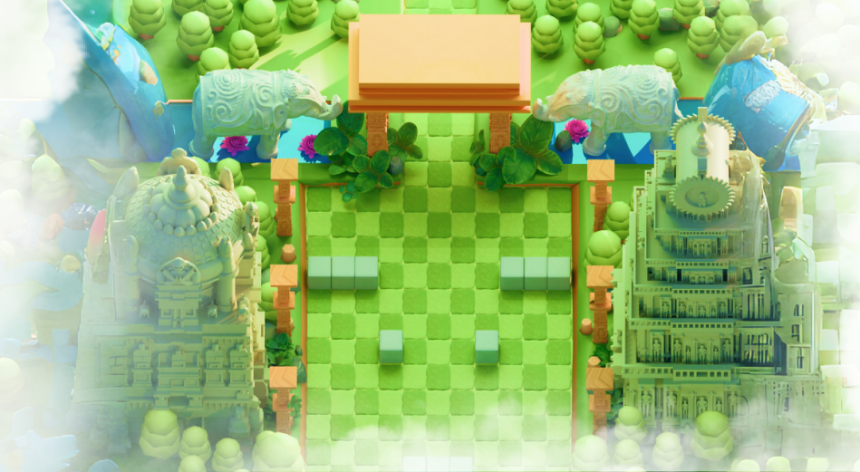
AYODHYA
Wega Labs

Slide 14
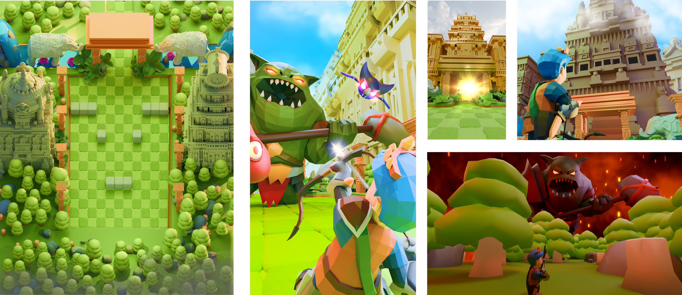
3D ENVIRONMENTS

Slide 15

Thank you so much
rb121202@gmail.com
+91-8624802918
www.linkedin.com/in/suman-biswass

